Slide 1
Brand Positioning and Global Expansion
Team PAOer
IIM Shillong

Slide 2
EXECUTIVE SUMMARY
Problem Statement & Objectives
The problem statement is to pique the younger generation’s interest in new products, win market and heart share in the Premium Segment in India and make it the springboard for global expansion; to develop the overall marketing strategy to project an aspirational image.
Approach
Overview
Market Research
Positioning
Global Expansion Framework
Promotional Strategy
Business Proposal
Recommendation & Conclusion
Market Research
The lack of personalized experience and low visibility among the target market
Dealers have low margins compared to the competitors and hence take a step back from the premium segment
Positioning
Dealerships to be presented to cater the personalized experience and meeting their desires and aspirations
One-stop, performance driven solution to meet the expectation of the target market
Promotional Strategy
Youth Engagement through college level challenges, provide a community experience, host live stunt shows, form expedition groups etc
Pitching the USP of the bikes, host trendy challenges on social media etc.
Global Expansion
Expansion in Colombia, the newly setup manufacturing plant, with strategic importance in LATAM
To launch a 2W EV Scooter as it is moving ahead with great potential with supporting laws and policies by the govt.
Executive Summary
Business Model Canvas

Slide 3
THE BUSINESS MODEL CANVAS
Key Partners
Aggravating on-ground sales executive for targeted marketing
Association with Society of Automotive Engineers (SAE) India
Develop a hyperlocal market
Key Resources
Expansion via collabs
Developing market presence through multiple channels for engaging youth
Value Proposition
Driving the consumers’ behavior towards personalized experience
Pitching the Unique Selling Proposition (USP)
Pocket-friendly, tech-loaded & youth centric one step solution
Customer Relationships
Portray customized experience
Community Building
Customer Segments
Younger generation which are:
Tech Savvy
Likes Innovative product
Enthusiastic
Adventurous
Creating Experience
Key Activities
Behavioural Change towards the premium bike segment of the younger generation
Channels
Broadcasting
Collaborations
Live Shows
Social Media
Outbound Marketing
Cost Structure
Partnership Costs
Marketing and Customer Services Costs
On-field drives
Incentives to Distributors
Revenue Streams
Market share increments
Global Expansion by introducing in an International Market
Sales of biking accessories
Executive Summary
Business Model Canvas

Slide 4
INDUSTRY OVERVIEW
2W Market Share in India in December’20
2W Premium Segment Market Share
Despite being the Market Leader in the Two-Wheeler segment in India with a Market Share of approximately 39%, Hero MotoCorp still struggles to gain the market share in the Premium Two-Wheeler segment (currently 3.52%)
According to CRISIL ratings, there is an estimated growth rate of 10-12% for the Two-Wheelers, which showcases a growth opportunity for Hero MotoCorp and increase the market share of their Premium Segment
Overview
Promotional Strategy
Business Proposal
Market Research
Positioning
Global Expansion Framework

Slide 5

MARKET RESEARCH
12
What Do You Understand by Premium Bikes
2
Telephonic Calls
Telephonic Calls
Market trends for “Premium” Segment bikes
Students
Travelers
Bikers
Working Class
Dealerships
Reason for Low Market Trends
Heard about Hero’s Premium Segment Bikes
Willingness to Shift to Hero Premium if certain features are made available
First brand name which strikes for “Premium Bikes”
The customers which come in, mostly prefer the other segment bikes
The Showroom lacks the experience associated with the Premium Bikes
Relatively low margins associated with the Premium segment bikes, hence the motivation to sell more of these becomes less
Customers are hardly aware about the premium segment bikes of Hero
Reason for choosing “Other” Brands
Brand Trust
Community Building
Word of Mouth
Availability
Exclusivity in Services
Premium Merchandise
Appealing Marketing
User Experience
Overview
Promotional Strategy
Business Proposal
Market Research
Positioning
Global Expansion Framework

Slide 6
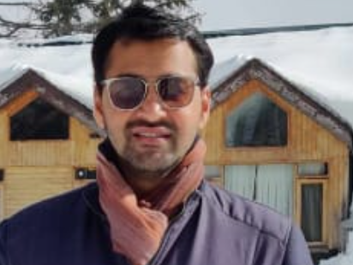
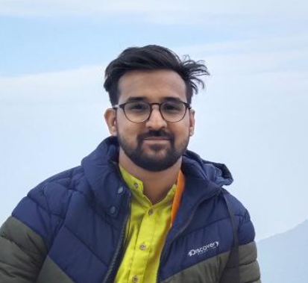
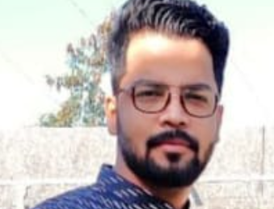
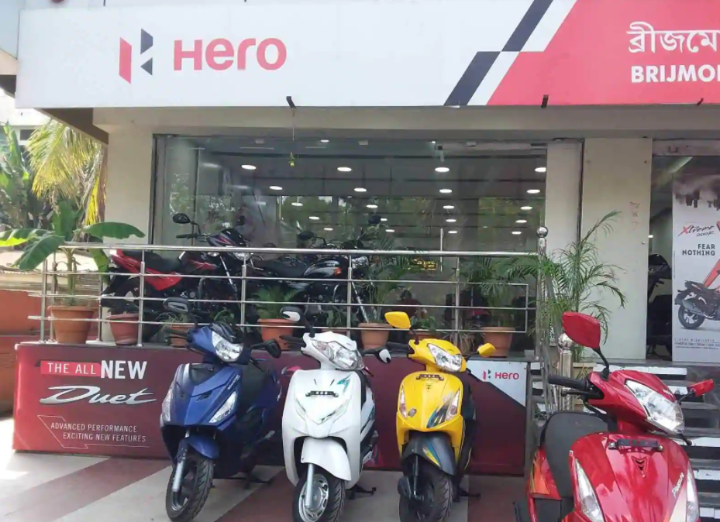
MARKET RESEARCH
Sidharth ,29
Currently looking to purchase a bike
Shreyas ,24
Currently exploring new bikes to purchase
Student Adventurer
Travel Enthusiast
Bike Lover
“ I have a certain budget constraints, but I am looking for a bike which I can use to go on adventurous expeditions and also use it for daily commute”
“ I have been looking for a feature loaded bike to go on adventures with like minded community of people, but I have not found the perfect match yet”
Aesthetically Pleasing
Pocket Friendly
Status symbol
Comfort
Community Building
Tech Loaded
Willingness to purchase Hero Premium
Willingness to purchase Hero Premium
Requirements
Requirements
Kunal ,35
Currently looking for an upgrade in the premium segment
Brijmohan &Sons
Looking to make better sales and increase the sales of the Premium Bike Segment
Working Professional
Hero MotoCorp Dealership
“I am looking to change my current bike and upgrade to a premium segment one which provides me with exclusive after sales services”
“ We get customers who are hardly aware about the Premium segment bikes. The margin which we get from Premium Bike sales are quite less when compared to the other segment, hence the quantity of Premium bikes in stock is usually less “
Performance Driven
Exclusive Services
Cost Saving
Better Margins
Awareness & Visibility
Successive Growth
Willingness to purchase Hero Premium
Requirements
Requirements
Overview
Promotional Strategy
Business Proposal
Market Research
Positioning
Global Expansion Framework

Slide 7
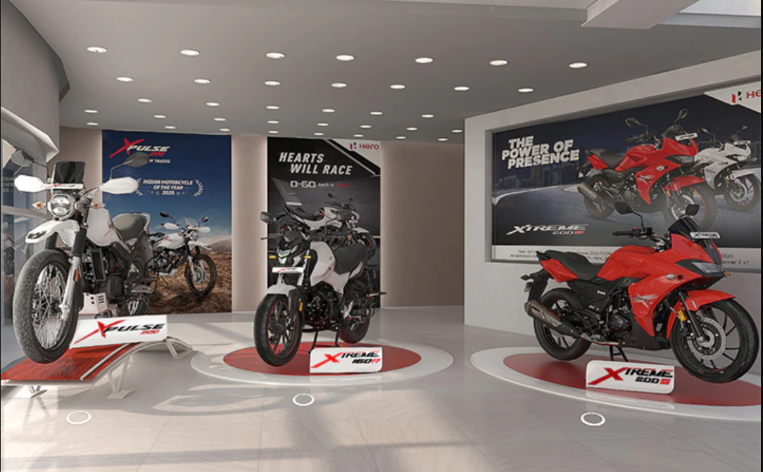
POSITIONING
Positioning
Proposing separate dealership – ALPHA, exclusively for Premium Segment bikes providing personalized experience
Segmentation
Youth Centric
Age – 21- 45 years
Income – Middle Class and above
More
Savings
Youth
Eccentric
Core Position
Enthusiastic
Meeting Desires and Aspirations
Innovative
Tech Loaded
Brand Position
Creating Experience
Exotic
Freedom
Targeting
How brand makes customer feel?
Dealerships for Premium Segment
Customer Perception created by the Brand?
Luxurious
Customize
One-Stop Solution
Young
Bike Lovers
Travel Enthusiasts
Adventure seekers and offbeat explorers
Daily Commuters
College Students
Working Professionals
Community Driven Individuals
Performance Driven
Provide a Personalized and Luxurious experience to the customers through the Premium Segment Showroom – Alpha
It will include Premium Merchandises and also provide access to the Hero Xtreme Cult (HXC) to the members
For Dealerships who which face issues related to less margins can now go for this exclusive dealership, and serve customers who are only looking for the Premium segment bikes, and in turn avail better profits
Substantiators
Pocket Friendly
Adventurous
Accomplishment
Aspirational
The Alpha Dealership will help to convert the desires and aspirations of the customers by providing them with the real time experience of the bikes right at the moment and this will lead to better conversion rate of customers
Overview
Promotional Strategy
Business Proposal
Market Research
Positioning
Global Expansion Framework

Slide 8
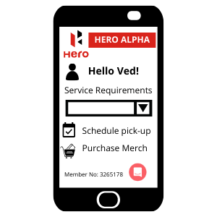
PROMOTIONAL STRATEGY
Alpha Showrooms
Hero Alpha APP
Introducing the Exclusive one stop solution for the premium offerings of Hero Moto Corp, with focus solely on the Premium Bikes and exclusive Merchandise with the help of specially trained staff and local integration
Incentivising the Dealers:
Personalized Experience
A members only application for premium bike purchasers allowing them to do the following:
Offering the Prospective dealers a margin of 7.5-8.5% on the sale of a premium bike. This is higher than the average margins prevailing in the market of 5-7% to incentivise the sellers to not only convert but also push sales
By Implementing Regional and hyperlocal market, Alpha showrooms will be able to offer its clients with an unmatched buy experience complimented with the use of consumer databases to conduct personalized targeting
Service booking for Valet pick-up for bike services and drop off
Cult details such as the trip schedules and possible expeditions for Premium bike owners
Premium Aftersales
Premium Merchandise
Alpha Showrooms would offer its customers options to get their vehicles picked up by a Alpha Employee and drop it off post services offering most ease and convenience
As a sign of belonging to a one big family driven by the love of biking, Alpha Showrooms would be selling its exclusive merch to promote the sense of belonging and difference.
Hero Alpha would also showcase member details, voucher available and a portal to purchase Alpha merchandise
Overview
Promotional Strategy
Business Proposal
Market Research
Positioning
Global Expansion Framework

Slide 9
PROMOTIONAL STRATEGY
Hum Mein Hai Hero Challenge
Advertisements
A Bike Engineering Competition for participants to race out their innovative designs and biking setups for a ultimate cash prize, seeing participation from Engineering Colleges across India.
The Market Positioning currently followed does not focus on key features of the Hero premium offerings. This can be coupled with a comprehensive market strategy making a complete use of endorsements.
A sponsored pan India Engineering Competition for Motorcycle Crafting and racing them out on tracks
Pitching USPs of GPS Integration in the Dashboard and Charging ports in the advertisements
A prize pool of INR 5 Lakhs to incentivize the participants to come up with innovative ideas
Live Stunt Shows and Trendy Challenges with Rider safety in mind to be conducted promoting the thrill
The competition will lead to a multiplier effect in terms of reach and word of mouth
Endorsements to be carried out with even more influencers and trending personalities exhibiting the values of speed, thrill and adventure
Xtreme Cult
Entertainment and Engagement
Community Building through organized Expeditions and cults intended to develop sense of belonging
Leasing out Hero Xtreme Bikes in areas with Off-roading Tracks and Potential to popularize the sporting experience through exclusive outlets in such locations also offering off-roading tracks and training.
Collaboration with Influencers and development of regional and state cults to go on semi-annual and annual expeditions with alpha merch dress code
Sponsoring vehicles in the Media creation Industry for commute in TV series and movies with respective value showcased in it
Overview
Promotional Strategy
Business Proposal
Market Research
Positioning
Global Expansion Framework

Slide 10
BUSINESS PROPOSAL
Investments made in 5 Years | Amount
Alpha Dealerships | 1706741550
Youth Engagement Initiatives | 330024157.9
Advertisements and Engagement | 122132757.2
Global Expansion | 6235378776
Total Investments | 8394277241
Revenues collected in 5 Years | Amount
Sale of new Vehicles | 13484114068
Sale of Spares | 441551557.5
Merchandise | 7380500
Sale of Licenses | 113570000
Total Revenue Generated | 14046616125
Profit over the course of 5 years
Rs. 390,21,29,501
Overview
Promotional Strategy
Business Proposal
Market Research
Positioning
Global Expansion Framework

Slide 11
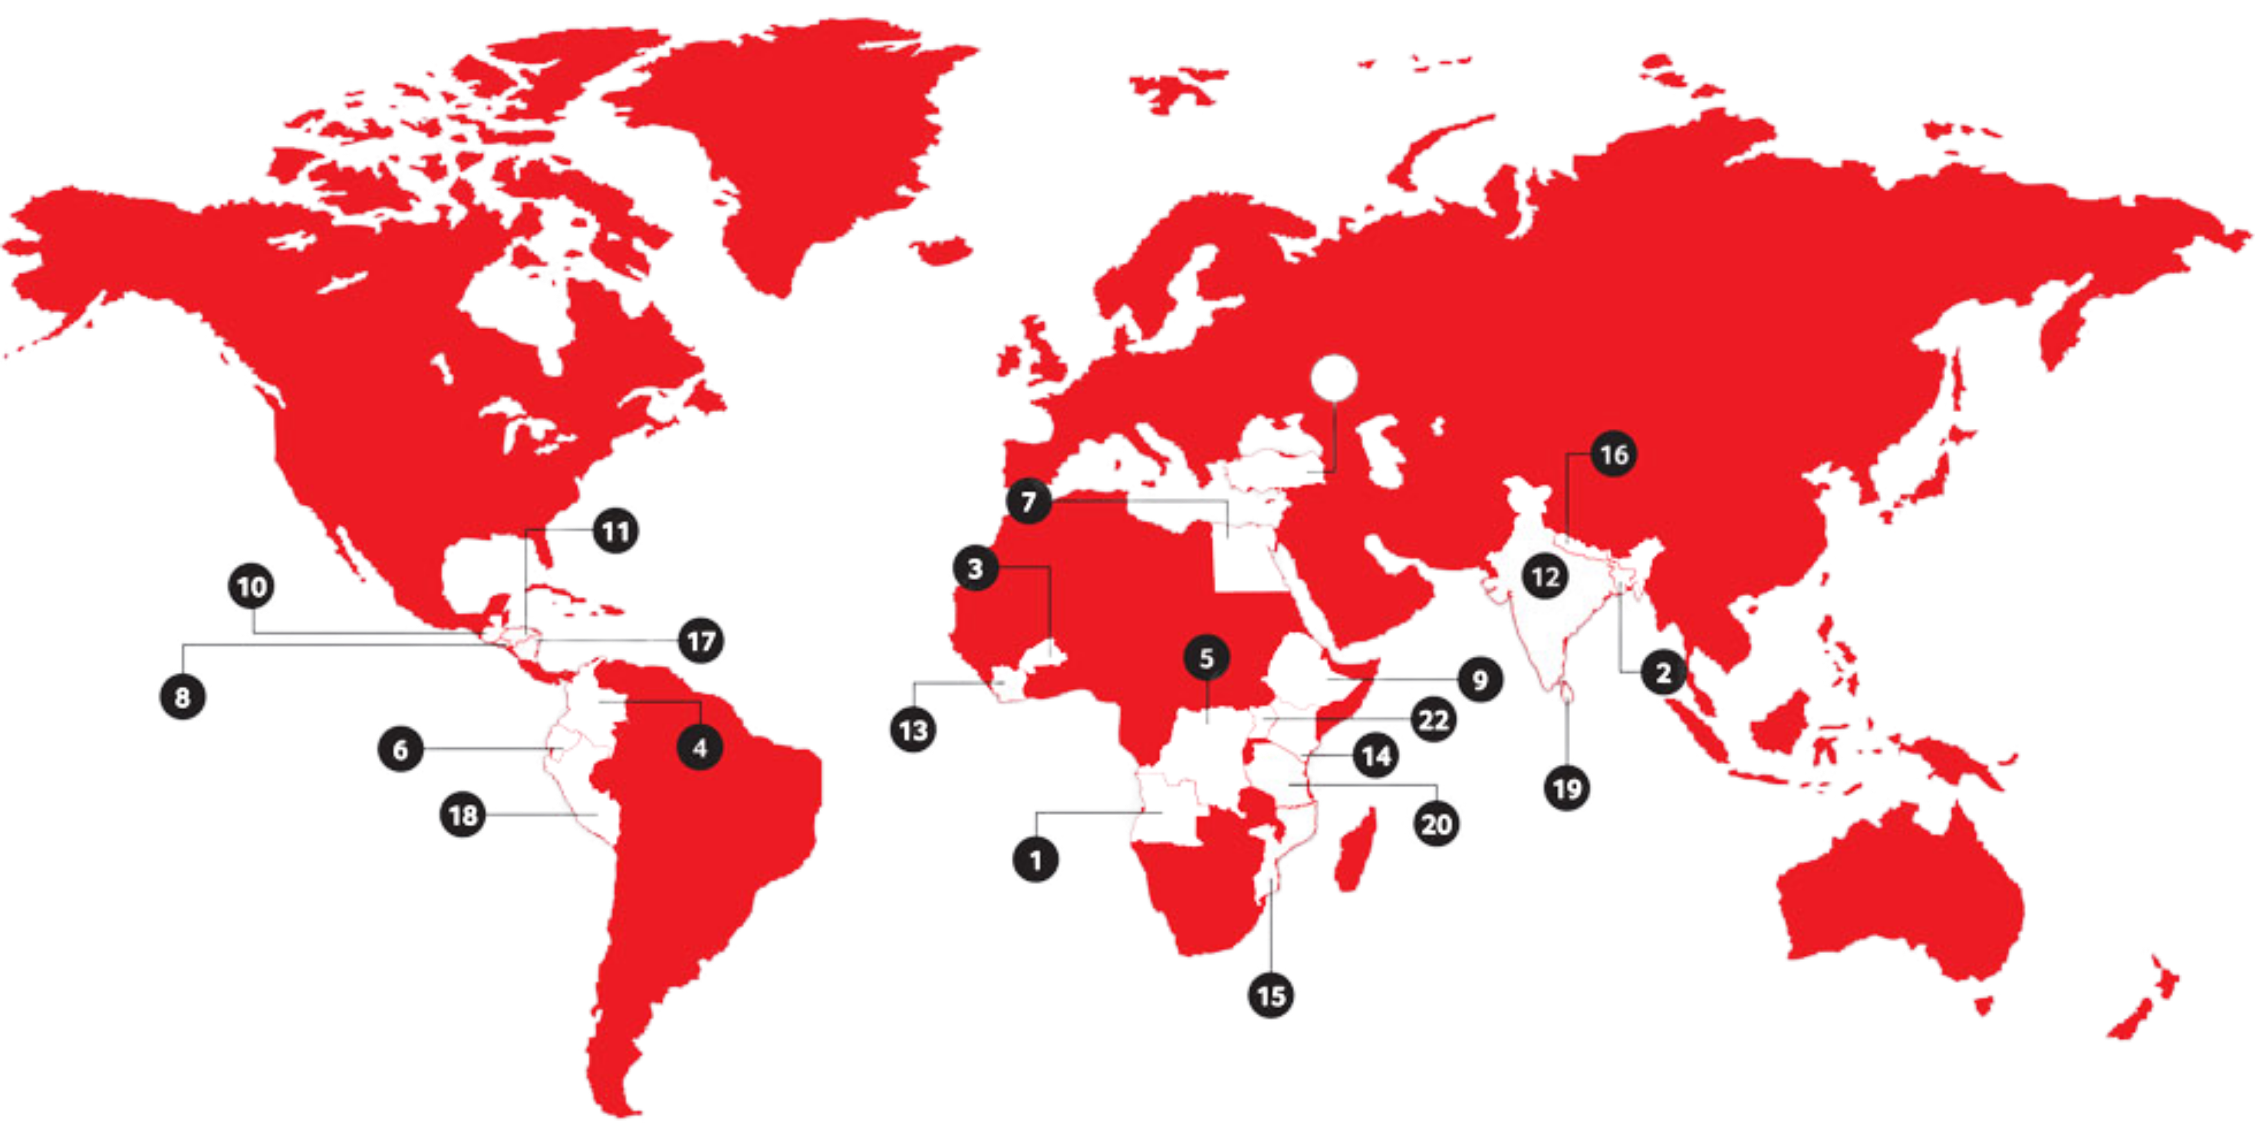
GLOBAL EXPANSION
Footprints of Hero MotoCorp
Angola
Bangladesh
Burkina Faso
Colombia
Congo
Ecuador
Egypt
8. El Salvador
9. Ethiopia
10. Guatemala
11. Honduras
12. India
13. Ivory Coast
14. Kenya
15. Mozambique
16. Nepal
17. Nicaragua
18. Peru
19. Sri Lanka
20. Tanzania
21. Turkey
22. Uganda
Hero MotoCorp have their manufacturing plants set-up in Bangladesh (JV), Colombia and India; former two being international locations
Target Market for Global Expansion is COLOMBIA for Two-Wheeler Electric Scooters as it is a emerging market leader in LATAM
First-Mover Advantage
HMCL is the First Indian 2W company to have a manufacturing plant in Latin America through our fully-owned subsidiary HMCL Colombia SAS
Expanding Operations
Act as a base for expanding operations to neighboring countries in LATAM; especially Brazil & Argentina (biggest market of 2W in region)
Sustainable Mobility
Colombia is transforming itself to be the market leader in the EV segment with several laws and policies in place by the government
Overview
Promotional Strategy
Business Proposal
Market Research
Positioning
Global Expansion Framework

Slide 12
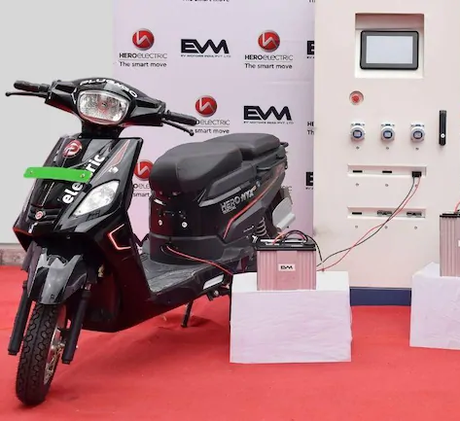
GLOBAL EXPANSION
Market Analysis
EV nos. shot up by 70% in last 18 months
EV infrastructure on the rise as per govt. directives
Defined EV parking in public spaces and larger municipalities’
Laws & Government Policies
Introduction of e-mobility law promoting sustainable transport, targeting 600k EVs by 2030
Green Road Infrastructure Guidelines setup for development of roads for sustainable mobility
Feasibility
MME Colombia indicate a 213% increase in no. of EVs sold compared to last year
Operational Production Plant
National Strategy for Electric and Sustainable Mobility launched by the government
Go-To-Market Strategy
Promote a pocket-friendly, “E-Mobility for all” campaign across all media platforms to generate new sensations
The President passed Law No. 1964, that brings the tax on motor vehicles will be paid on 1% of the total commercial value of the EV
Goals of the Colombian Govt.
At least 10% of the vehicles purchased must be electric or zero emission from 2025
The goal is that 100% of the vehicles purchased to replace or increase the transport capacity are electric or zero emissions from 2035
With booming EV infrastructure and multiple policies in place, support from the government and considering the operational feasibility (low cost) of HMCL, Colombia is the best market for global expansion & can also cater the LATAM region going forward
Overview
Promotional Strategy
Business Proposal
Market Research
Positioning
Global Expansion Framework

Slide 13
THANK YOU

